Slide 1
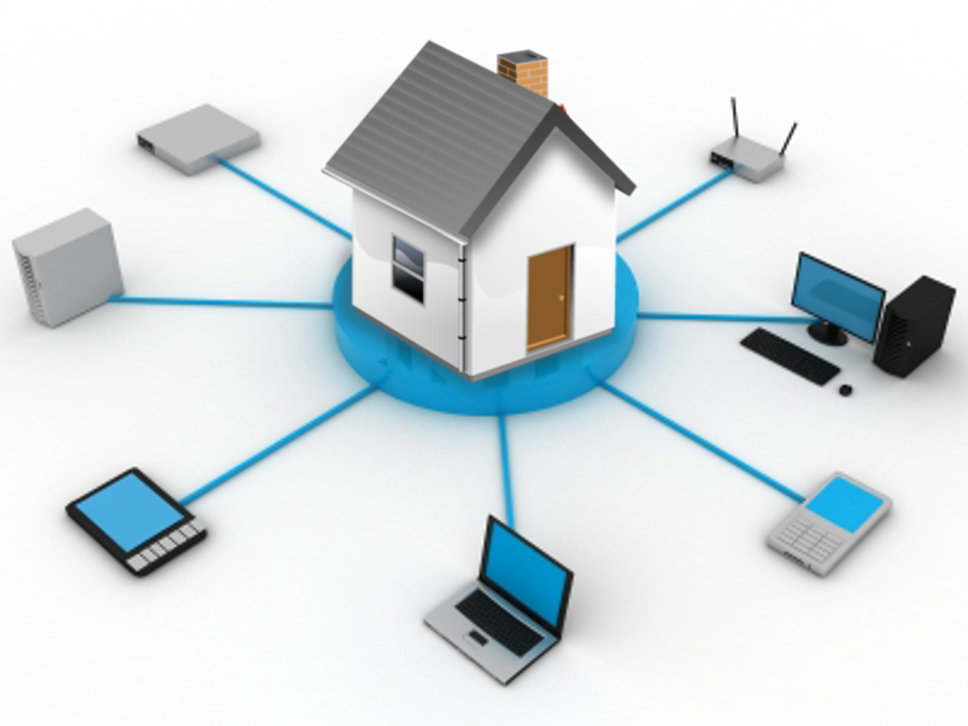
Introduction to Home Networking
Part 2
Kelvin Cording
April 2019

Slide 2
Review - Part 1
IP Addresses
Connecting PC to router for local Lan connections
What is DHCP
Connecting to NAS (Synology)

Slide 3
Home Networking Part 2
Domain Name Server (DNS)
Port Forwarding
Static & Dynamic DNS
Accessing Home Network externally from Internet
Smartphones, Tablets & Desktop clients
Application to Synology NAS

Slide 4
Link to Video Here

Slide 5
Review -
Port Forwarding
Link to Video HERE

Slide 6
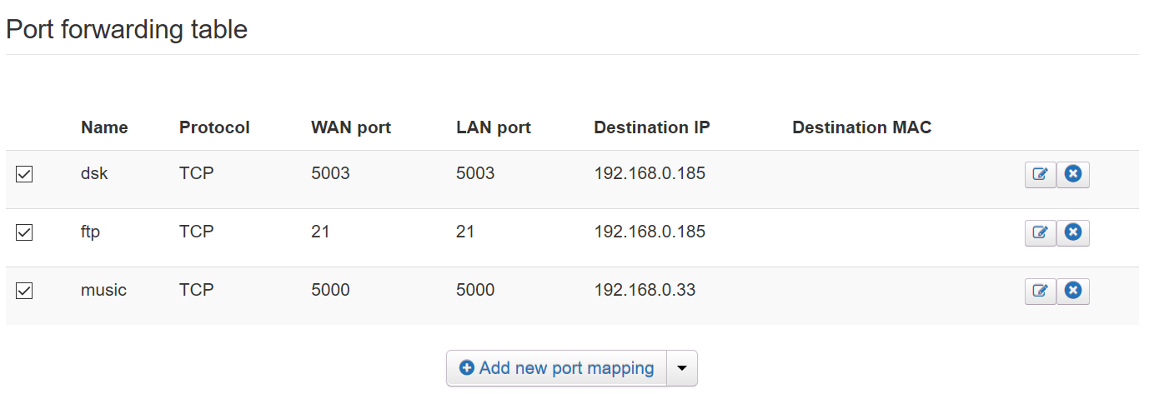
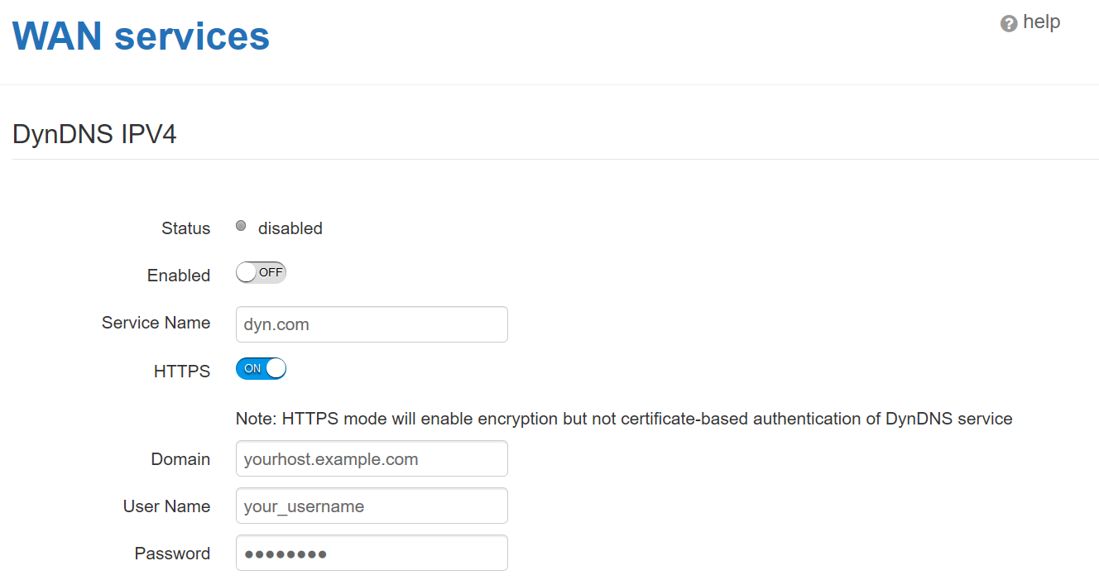

Slide 7
Dynamic IP
ISP provides an IP address
that may change from time to time.
Static IP
ISP provides the same IP address all the time.
Link to Video HERE

Slide 8
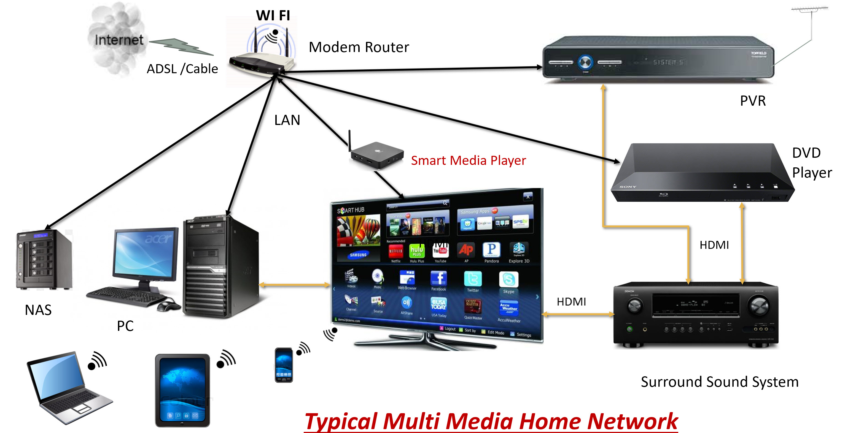
Clients connecting from outside local network
Using Static IP Address
Port Forwarding
Synology

Slide 9
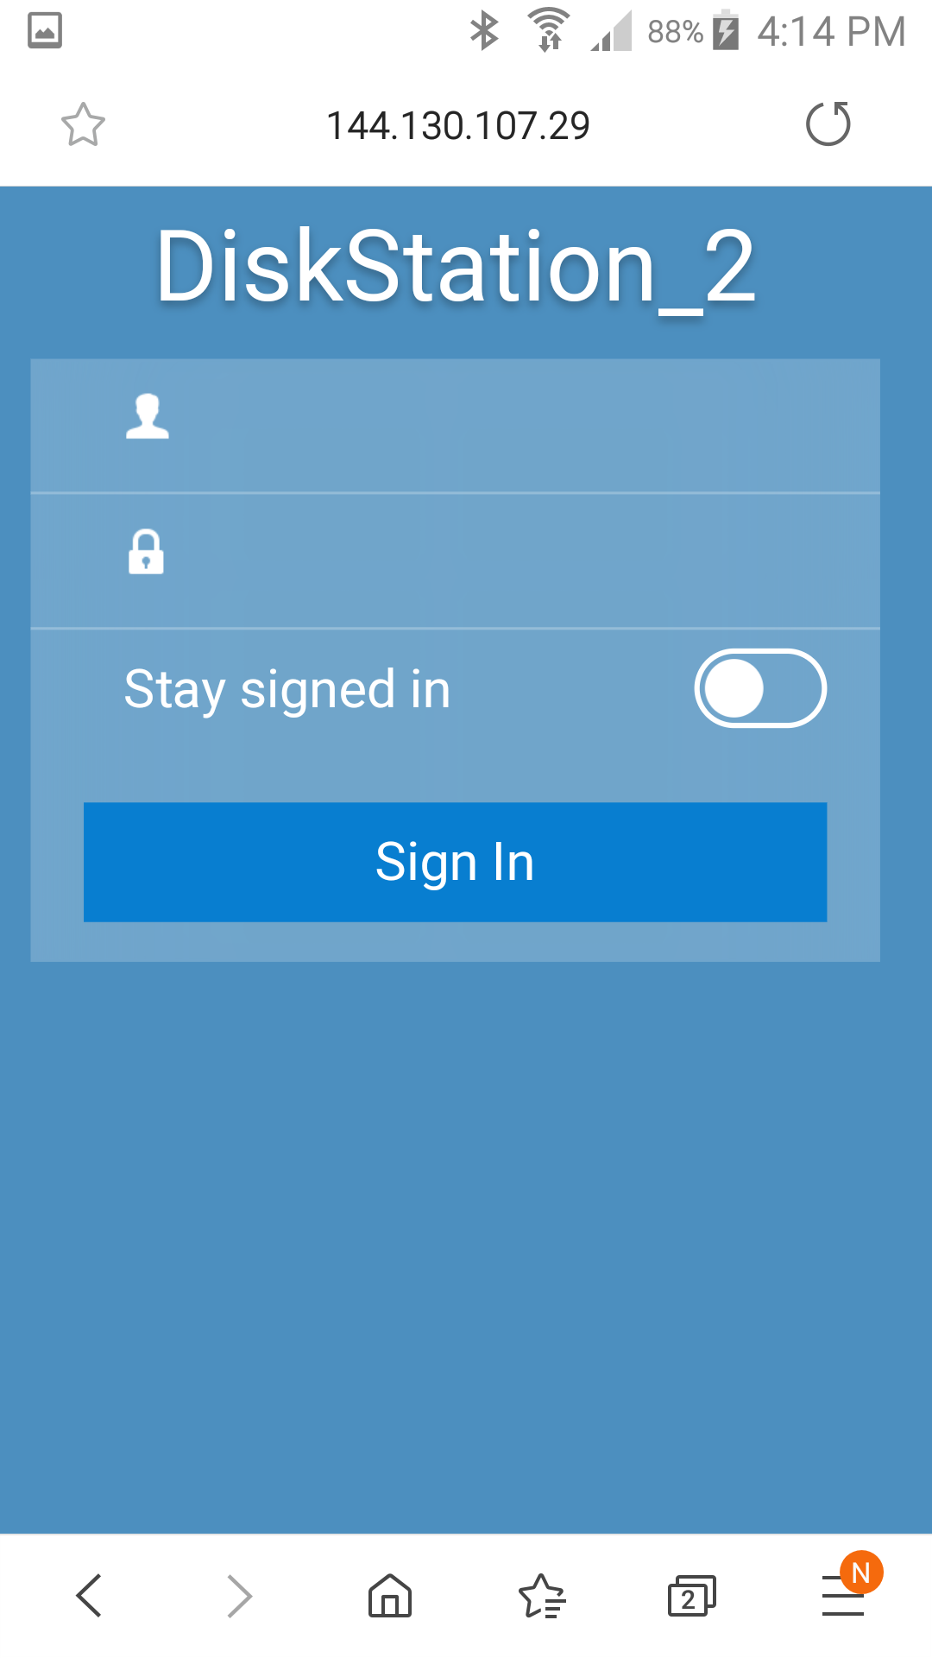
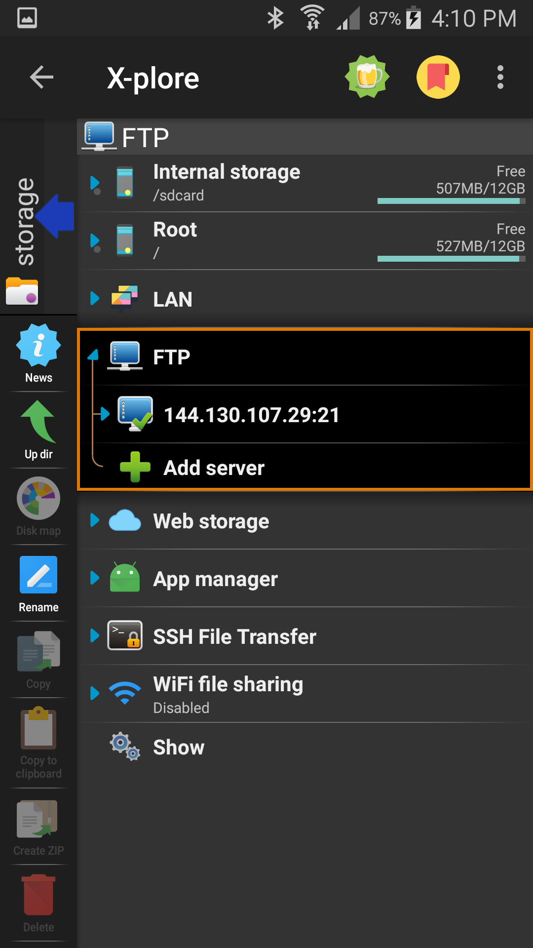
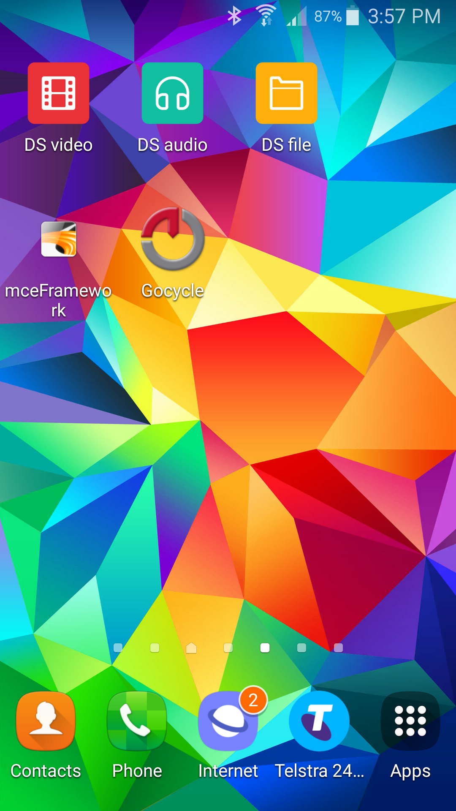
Google search with http://
FTP Client (in X-plore)
Synology Applications
Smartphone Clients

Slide 10
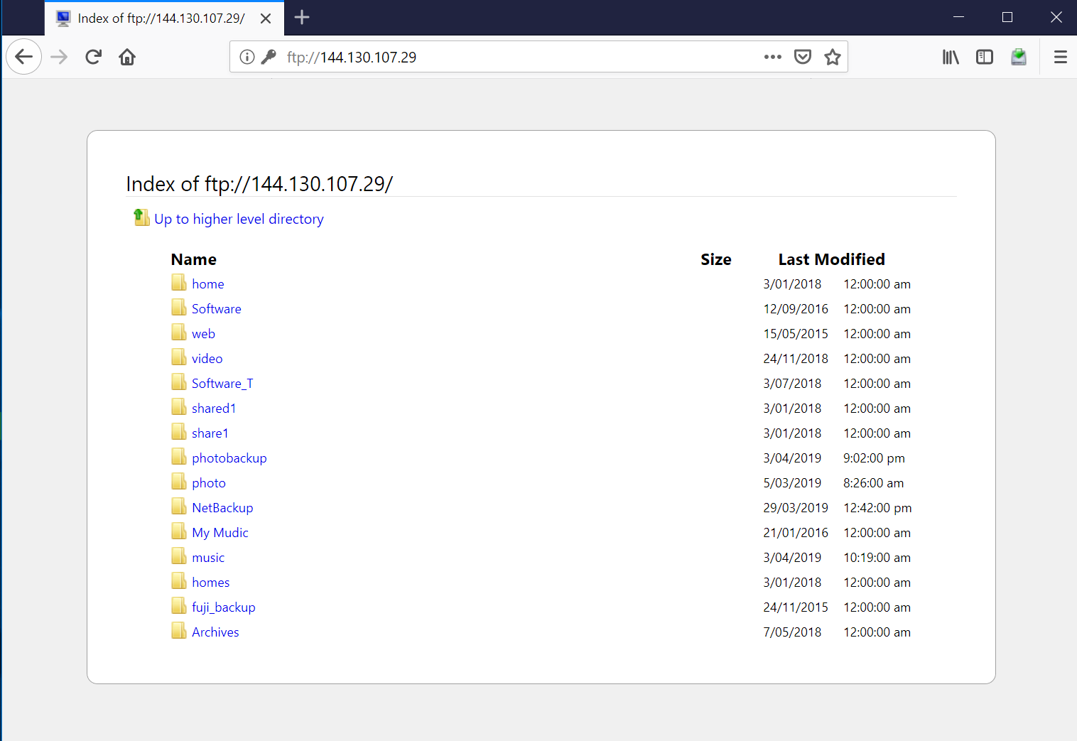
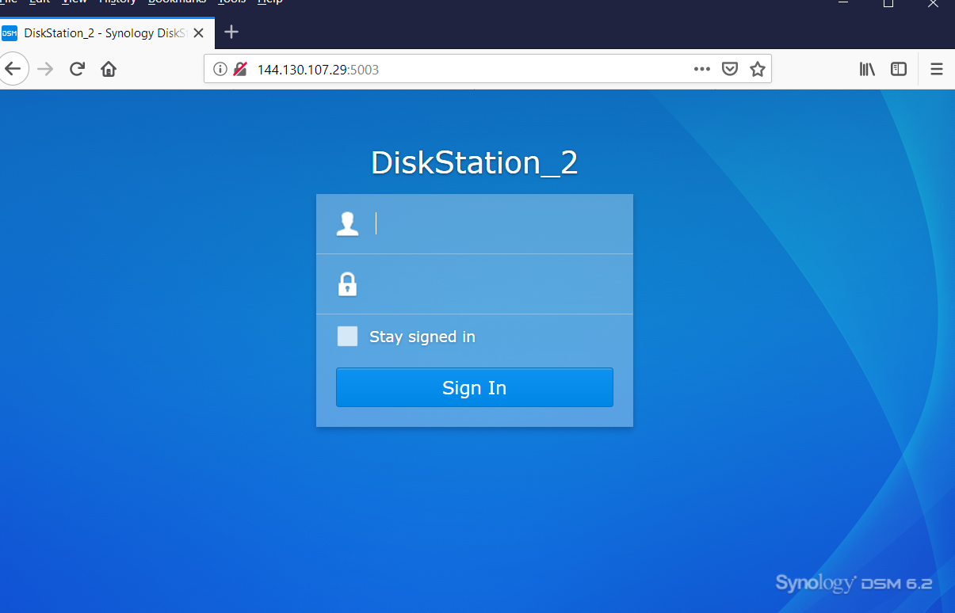
FTP using Firefox
Http:// (with Static IP address)
Desktop Clients

Slide 11
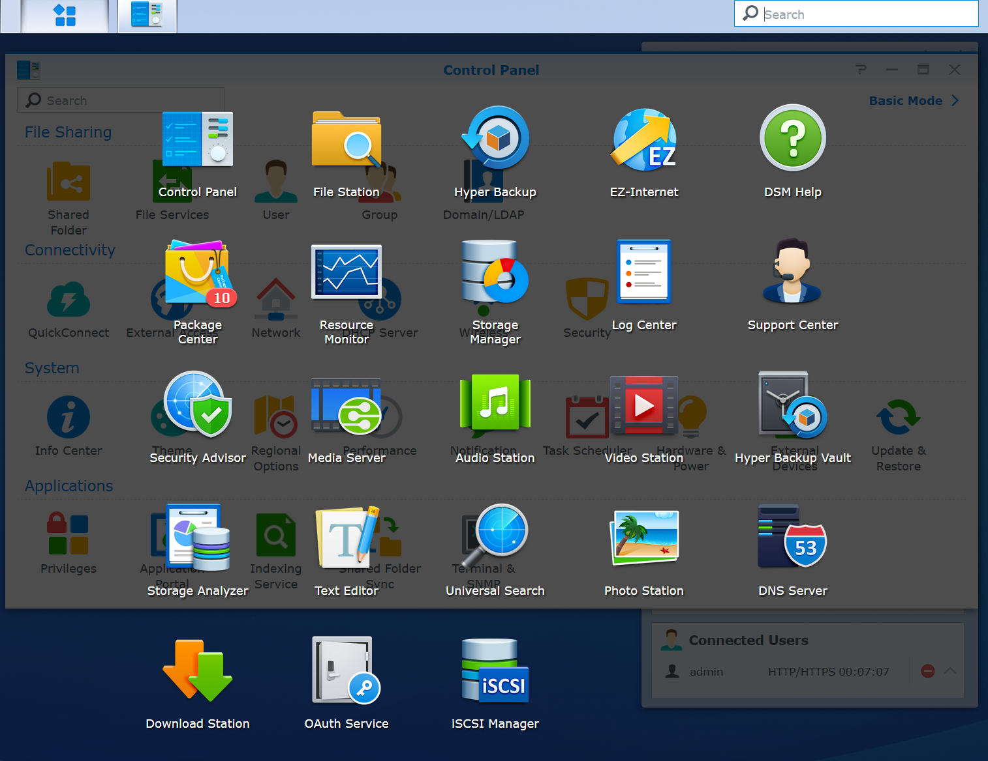

Slide 12
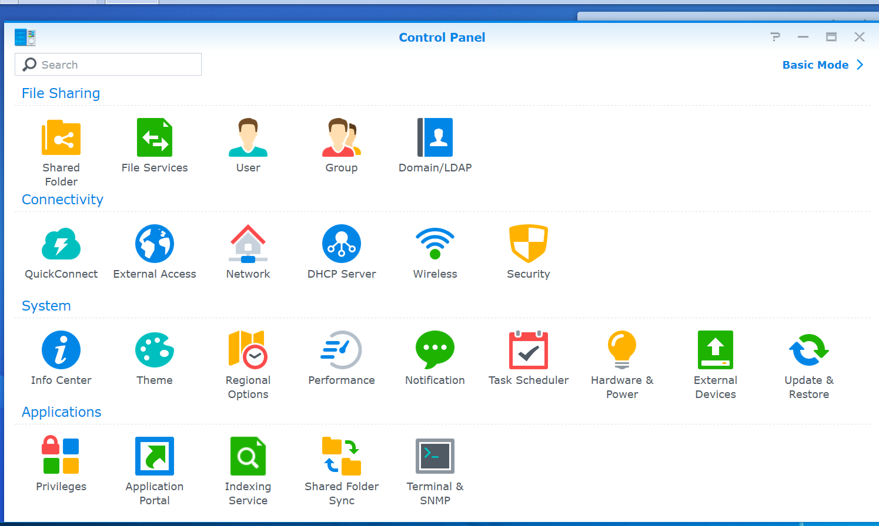
Synology Control Panel

Slide 13
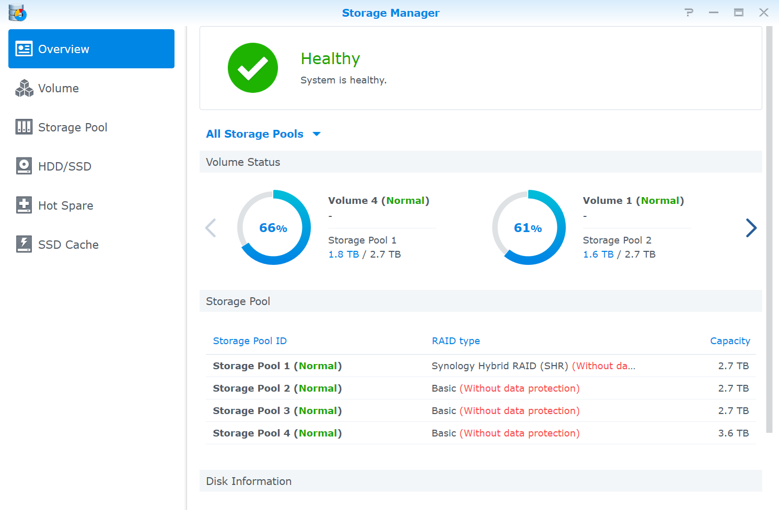
Synology Storage Manager

